Slide 1

Investment Pitch
15th of June, 2020

Slide 2







What’s Freekick?
Performance Metrics
Match Reports
Match Videos
Psychological Analysis
Football Scouting Team
Scouting Applications
Notes:
Mission: “Freekick strives to offer the best scouting tool, providing the most extensive scouting experience at the fairest price in the market”
Vision: “Become the top digital ecosystem that provides extensive information about potential and professional football players”

Slide 3
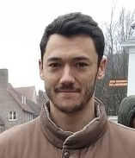
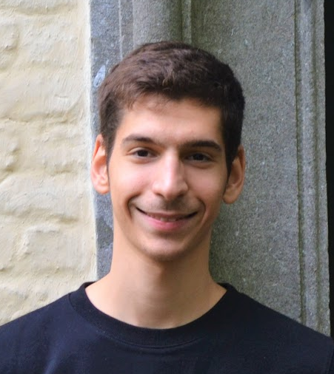
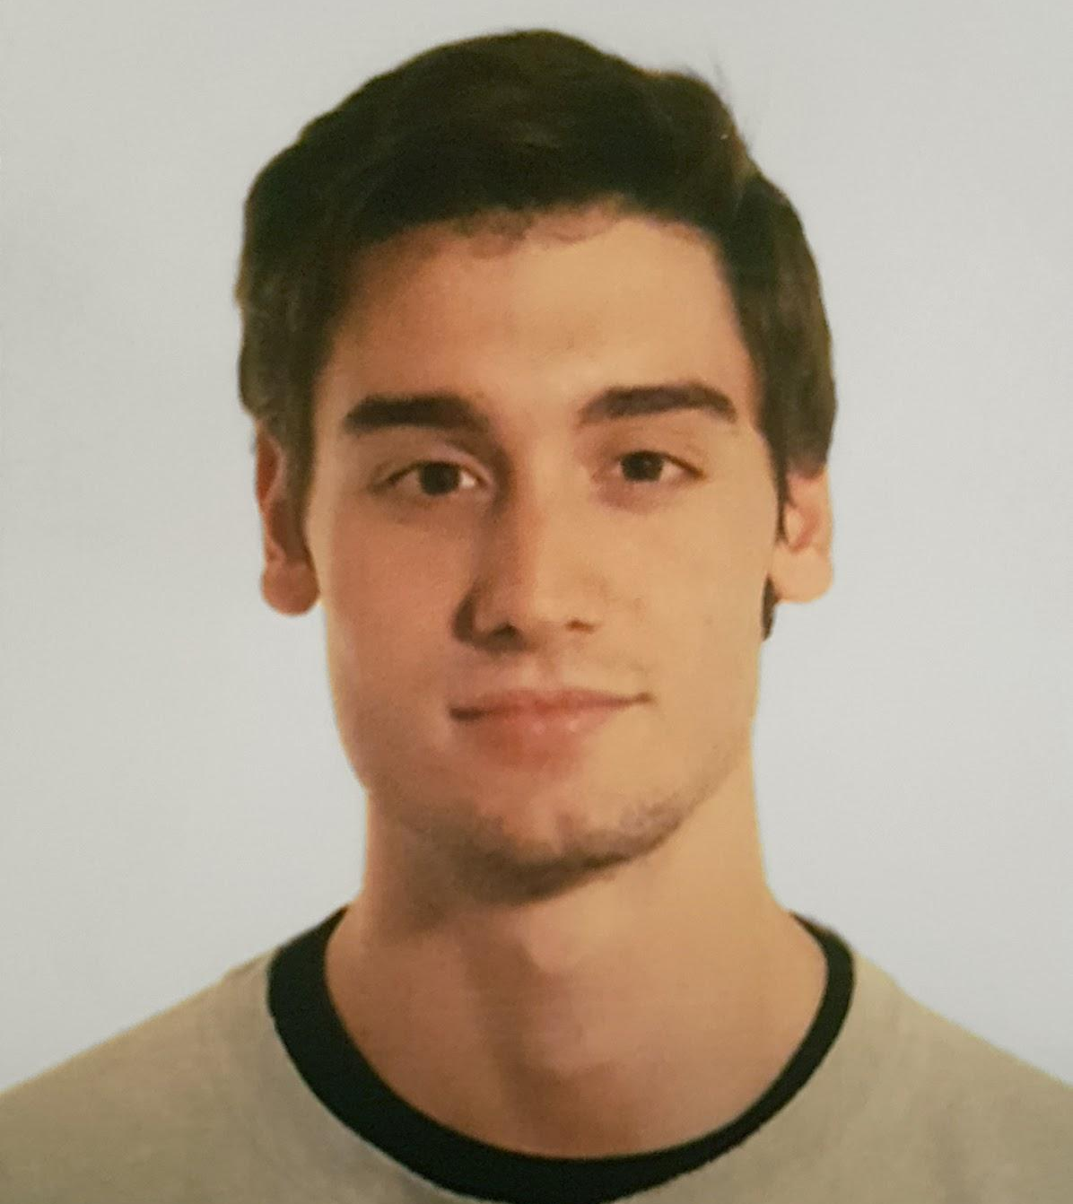
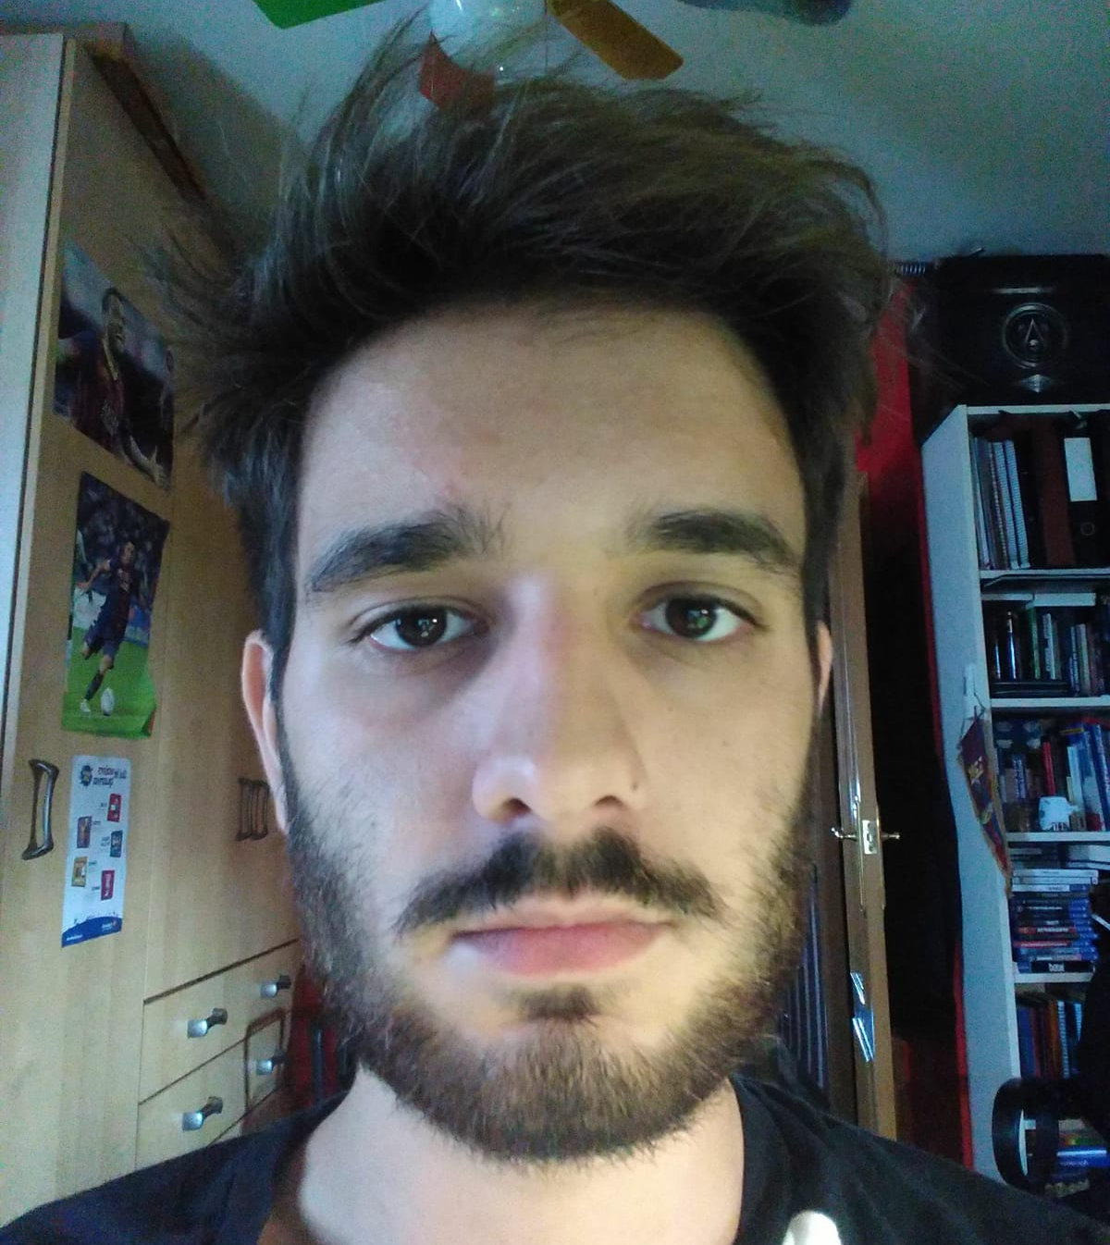

The team
Dimitris (Greece)
Andrea (Italy)
Ricardo (Spain)
Adrian (Spain)
Jesus (Mexico)
Notes:
Here we can briefly extend each one of our profiles/CV as we present the members. No need to overcrowd the slide.

Slide 4
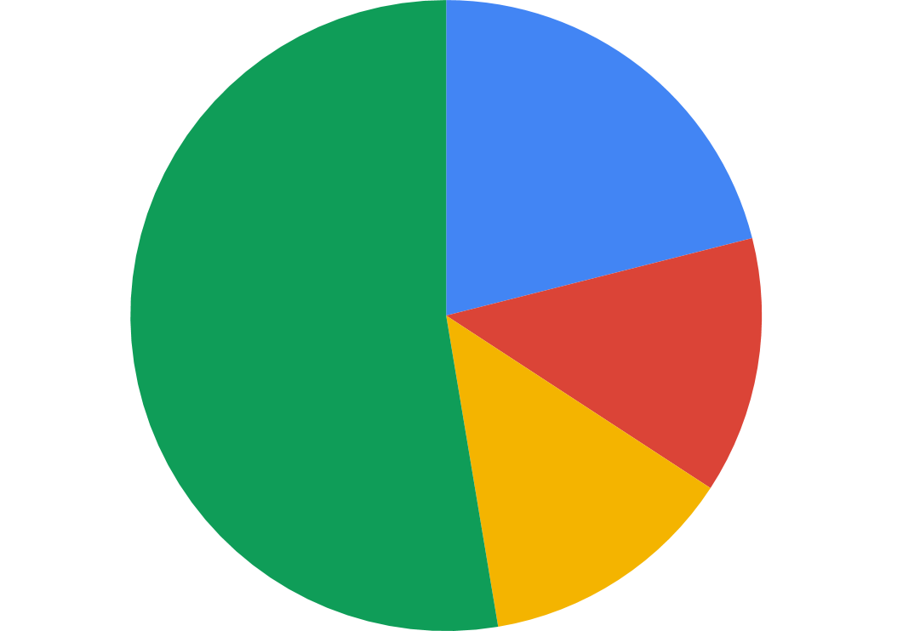
How are we selling?
Yearly Subscription
# Players Scouted
21.1%
52.6%
Performance Metrics
13.2%
Regions Scouting
13.2%

Slide 5
Demo

Slide 6
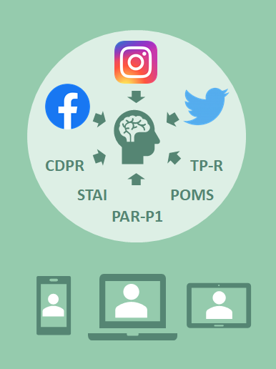
Where’s the innovation?
1
Retrieve player’s data
Retrieve player’s data
2
Fit data into our psychological analysis model
Fit data into our psychological analysis model
3
Classify players based on club’s needs

Slide 7
Football Teams Feedback
Aris Thessalonikis F.C.
Women’s Greek National Team
Norwich City F.C.
Psychological information is not enough
Reach out to FIFPRO
Focus on unknown players
Women’s football as a big market
Player’s interviews as source of information
Lead scouts do social media research

Slide 8



Where will we focus?
EU
World
Other Sports
∞
36 Leagues
+10,000 Teams
208 Leagues
+26,000 Teams
*FIFA members (fifa.com)

Slide 9






Who are our competitors?
Football Scouting Apps
Psychological Scouting Apps

Slide 10








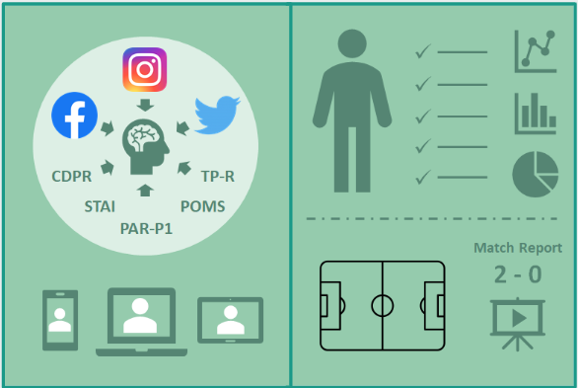
How to approach our market?
Place
Promotion
Product
Price
Basic vs Pro
Notes:
Info in the report. 4 Ps.

Slide 11
Financial plan
Profit & Loss Year 1
Sales | 230,000.00 €
Cost of Goods Sold | 24,000.00 €
Gross Margin | 206,000.00 €
Total G&A | (197,060.00 €)
Operational Margin | 8,940.00 €
Profit Before Tax | 6,103.00 €
Net Profit | 4,577.25 €
Gross Cash Flow | 11,263.00 €
Net Cash Flow | 9,737.25 €
EBITDA | 14,100.00 €
Fixed Assets | 27,200.00 € | Equity | 100,000.00 €
Current Assets | - € | LT Liabilities | 45,392.00 €
Treasury | 129,540.00 € | ST Liabilities | 11,348.00 €
Total Balance | 156,740.00 € |  | 156,740.00 €
Year 0
Balance Sheet
Fixed Assets | 27,200.00 € | Equity | 100,000.00 €
Current Assets | - € | LT Liabilities | 34,044.00 €
Treasury | 129,540.00 € | ST Liabilities | 11,348.00 €
Total Balance | 156,740.00 € |  | 156,740.00 €
Year 1

Slide 12
Investment & Balance
64%
Founding partner’s investment
€156,740.00
36%
5-year bank loan

Slide 13
Treasury Plan
Month
1
5
6
11
12
Sales collections | 0 | 50,000.00€ | 50,000.00€ | 20,000.00€ | 35,000.00€
TOTAL COLLECTIONS | 0 | 50,000.00€ | 50,000.00€ | 20,000.00€ | 35,000.00€
Operating payments | 17,170.00€ | 17,170.00€ | 17170.00€ | 17,170.00€ | 22,838.00€
Loans pay back |  |  |  |  | 11,915.4€
TOTAL PAYMENTS | 17,170.00€ | 17,170.00€ | 17,170.00€ | 17,170.00€ | 34,753.4€
INITIAL TREASURY BALANCE | 129,540.00€ | 75,192.00€ | 108,022.00€ | 121,504.00€ | 124,334.00€
FINAL TREASURY BALANCE | 112,370.00€ | 108,022.00€ | 140,852.00€ | 124,334.00€ | 124,580.6€
Notes:
Operating payments increase in month 12 is due to Taxes payment (which also occurs in month 4 and 8).
Loans pay back at the end of the year (1 of the 5 year payments).

Slide 14
Thank you for your time!
Q&A

